Slide 1
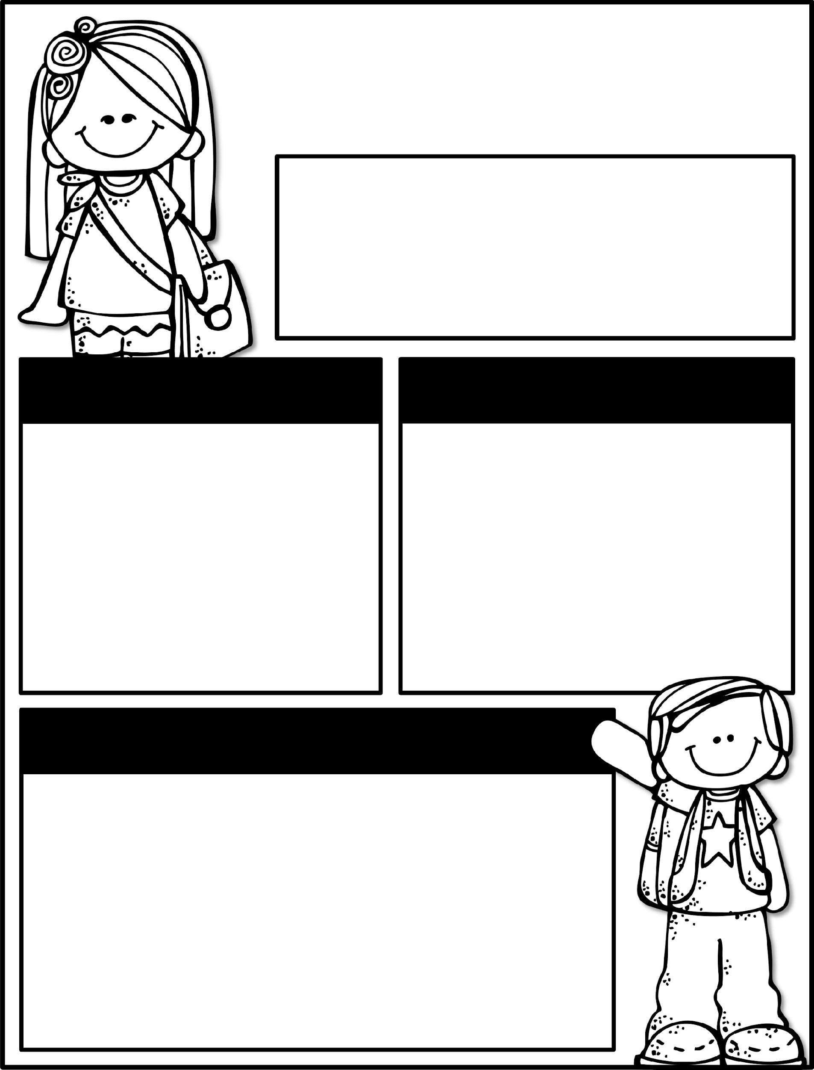

Kindergarten News
October 7-11, 2024
Class News
Learning Focus
The NHE Cafe will be closed for visitors Monday and Tuesday, October 7th and 8th.
We know that this is a busy time for everyone; a list of dates is going home today, please keep this somewhere safe to refer back to. This Friday is an Early Release Day - we will dismiss at 11:15am. If you do not send a transportation note, I will assume that your child is going home their typical way. Our field trip is coming up soon! If you’d like to be a chaperone, background check forms should be turned in no later than this week, but we still cannot guarantee that they will come back before we go. Any adult listed on the yellow card may come as a chaperone.
Upcoming Events
Learning Focus
10/10 - Talent Show @ 6:30pm
10/10 – Poetry contest
10/11- Early Release – dismissal @ 11:15am
10/17- 50th Day of School
10/18 – Kona Ice
10/18 – T-shirt money due
10/18 – Field Trip permission slip and money due
Birthdays
Liam 10/12
Ember 10/24
Reading: Asking and answering questions about key details, characters, and setting
Writing: Informational text
Math: Counting 0-20 in various arrangements
Phonics: Letters / Letter sounds
Science: Sink and float
Sight Words to practice
a, the, as, to, do, I, is, am, at, an, man, in, it, was, you
Contact Me:
Email: olivia.otis@henry.k12.ga.us
School Phone Number: 770-898-7362
Reminders
Please check your child’s binder each night. Check Dojo each night.
Ask questions if you have them!
Please send a water bottle and daily snack for your child.
Please keep a change of clothing in your child’s bookbag .
We have completed the GKIDS assessments. This measures what your child knows entering kindergarten. Your child’s report will be his/her first report 9-week report card.

